Slide 1
Wednesday Night Bible Study
Noah: Intro & Ark
Genesis 1-6

Slide 2
1. The Beginning – Genesis 1:1-2:7
1:1 – God literally breathed (inspired – II Tim. 3:16)
1:5 – how long were these days? 24 hour periods
Things created:
Light & Dark
Clouds & Oceans
Sun, Moon, Stars
Land, Plants, Trees
Fish & Birds
Man & Animals

Slide 3
1. The Beginning – Genesis 1:1-2:7
2:3 – Garden of Eden (Septuagint: Paradeisos)
2:20 – no help meet for Adam
2:22 – married by God
3:1-19 – Satan & sin
3:21 – God covered their sin
4:1-24 – Cain & Abel
4:25 – Seth is born – continues the line of Christ
Ch. 5 is often overlooked due to the names

Slide 4
1. The Beginning – Genesis 1:1-2:7
Quick Genealogy:
Adam 930 -----
Seth 913 800
Enos 905 665
Cainan 910 575
Mahleel 895 505
Jared 962 440
Enoch 365 308
Methuselah 969 243
Lamech 777 56

Slide 5
2. Noah on the Scene – Genesis 6:1-12
1 – Multiplying
3 – Lifetime of people reduced
4 – 2 thoughts on ‘giants’
Giants in Numbers 13:33 but cannot be the same
Nephilim ‘Fallen Ones’ denotes the status of man
5 – Thoughts were only evil
6 – repented: Hebrew: to sigh or breathe heavily
7 – completely reverse His handiwork

Slide 6
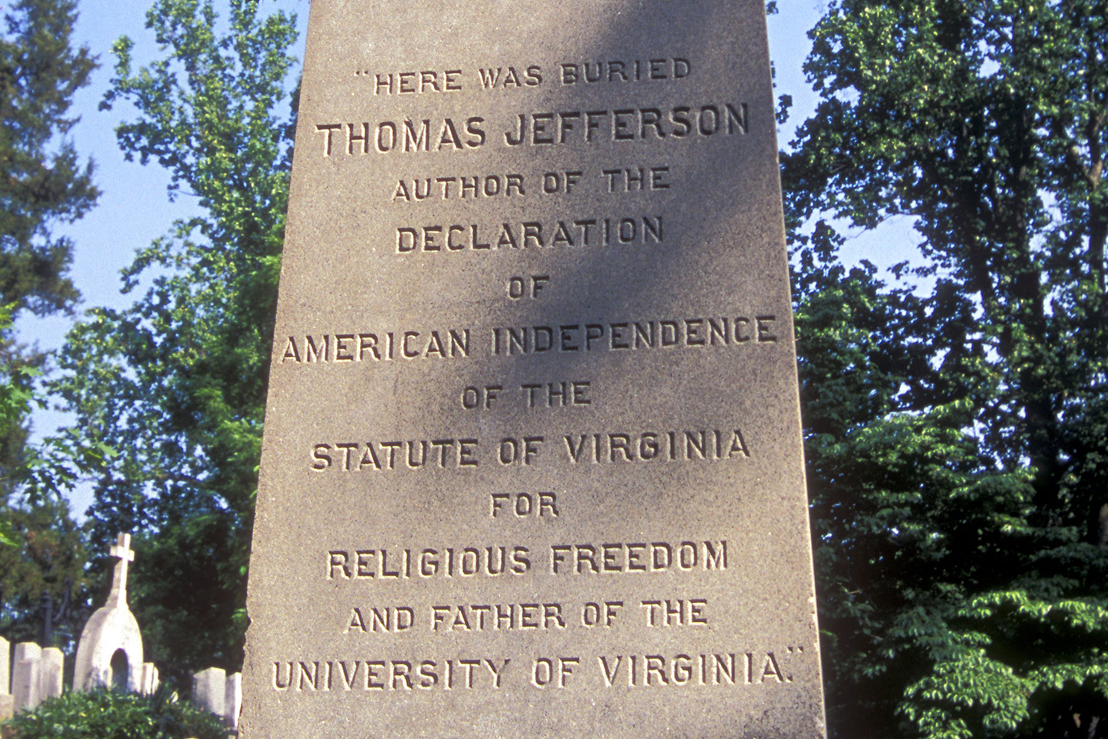
2. Noah on the Scene – Genesis 6:1-12
8 – key verse
Tombstone

Slide 7
3. God’s Instructions to Noah – 6:13-22
13 – God spoke directly to Noah; YWHW used
14 – Hebrews 11:7
15 – How big was the Ark? ‘show your work’
300 cubits long X 1.5 ft = 450 ft = 1½ football fields
50 cubits wide X 1.5 ft = 75 ft
30 cubits high X 1.5 ft = 45 ft = ~5-story building
3 decks = 101,250 ft² = 21 basketball courts
To walk just the decks = 0.6 miles
Cargo = 1.5 millions ft³ = 50 railroad cars

Slide 8
3. God’s Instructions to Noah – 6:13-22
16 – 1 window @ 1 cubit; 1 door
17 – everything that breathes is to be destroyed
18 – covenant – promise – to 8 people
19 – 2 of every kind, possibly a type
21 – gather grain – everyone eats grain
Key verses 8 & 22

Slide 9
4. Lessons
Don’t miss the boat.
Stay busy – Noah was both physically and spiritually fit!
God seals the door. God is responsible for our salvation.
We must develop complete obedience to God and His commands.
Notes online: Google: Justin Reed Bible thejustinreedshow.com/bibleresources

Slide 10
Next Bible Study:
Thursday 6:30pm
with Bill Boyd and Justin Reed

