Slide 1
“Live at Five” Series: Earthly Wealth
Matthew 6:19-21

Slide 2
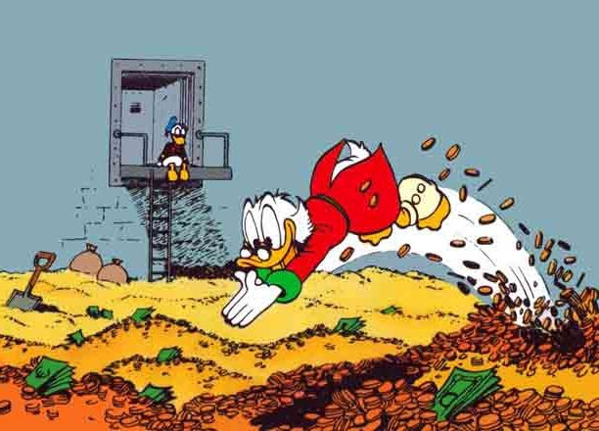

Slide 3
1. Blind Us – Joshua 7
Background – chs. 2 & 6
God was angry at Achan – ch. 7
Took of the accursed things
7:10-12
7:13-15 – remove themselves
7:16-21 – his guilt got to him
7:22-26 – “Those Achan Eyes”

Slide 4
2. Keep Us from Heaven – Mt. 19:16-22
Just finished “M-D-R” & be like children
Question and rebuttal – 16-20
The kicker – 21
The response – 22
He left
He was rich
He enjoyed possessions more than service

Slide 5
3. Mean Nothing if Priority – Ec. 1:1
King Solomon – richest man ever!
I Kings 10:23
Math: 2016 figures
Bruce Wayne: $10 billion ($10,000,000,000)
Scrooge McDuck: $65 billion
John D. Rockefeller - $663.4 billion
Solomon - $2.1 trillion ($2,100,000,000,000)
Yearly: 666 talents of gold – I Kings 10:14
Extent of his wealth – I Kings 10:14-29

Slide 6
3. Mean Nothing if Priority – Ec. 1:1
BUT – Eccl. 1:2 – from the man that had literally everything that money can buy!
Eccl. 5:10
When wealth becomes your goal, it becomes useless!

Slide 7
Is it wrong to have wealth? NO!
If wealth becomes all you think about (a god to you) then YES!
What do we do now? Eccl. 12:13-14
Don’t let ANYTHING keep you from Heaven!

Slide 8
Notes available online:
thejustinreedshow.com/bibleresources
Google: Justin Reed Bible
Notes found in the ‘Sermons’ section.

Slide 9
Next Scheduled Live Study:
Wednesday 6:30pm – Midweek Bible Study “David Shows Courage”
Thursday 6:30pm – Matthew 16 with Bill Boyd and Justin Reed

