Slide 1
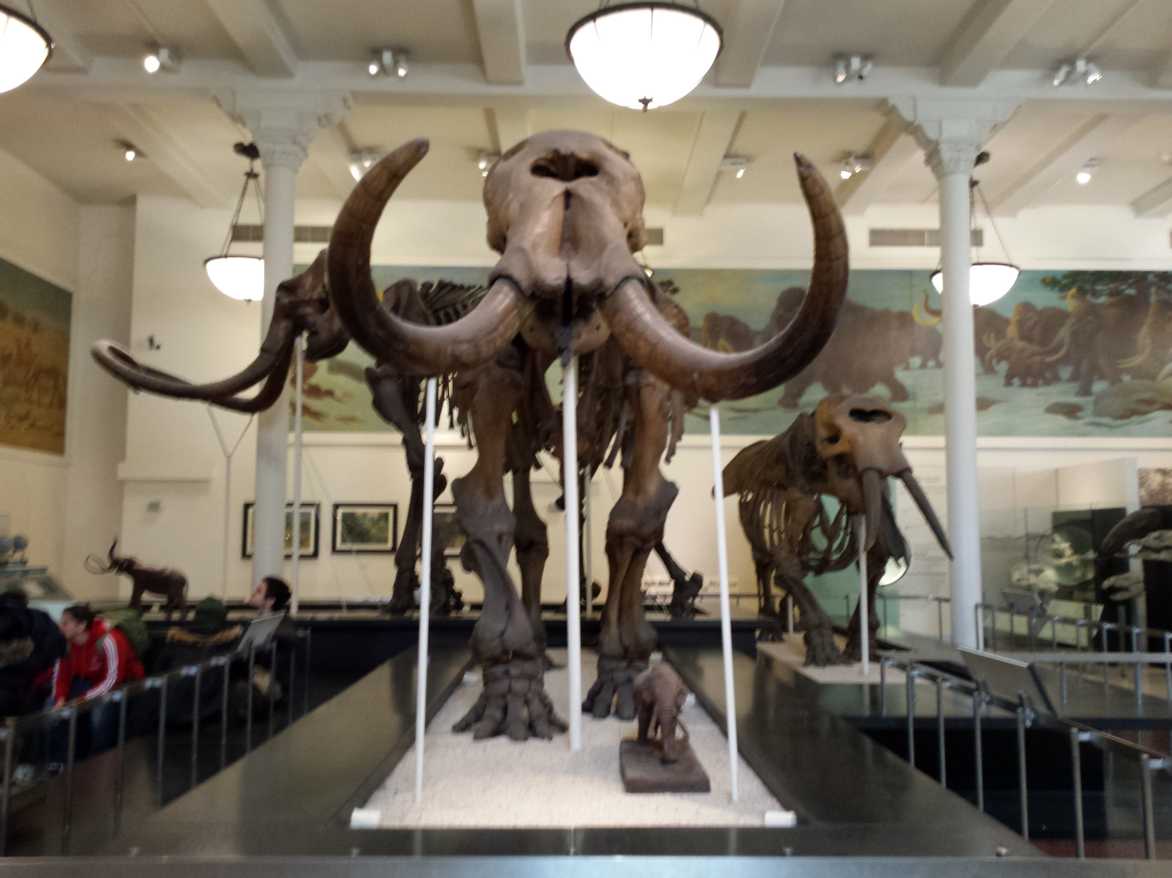
Dinosaurs and the Bible

Slide 2
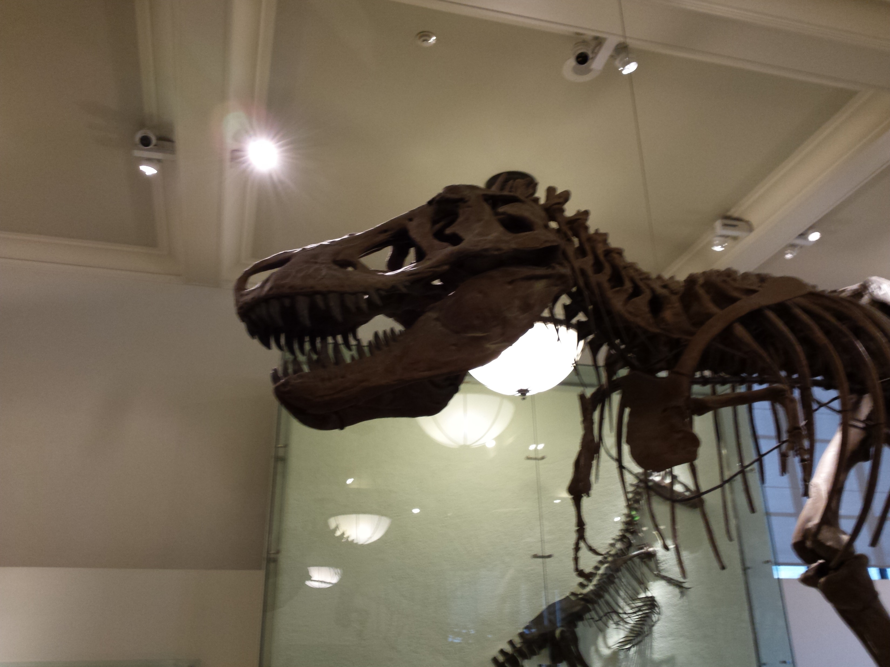
Begin: find and underline every appearance of the word dinosaur in the Bible.
1. Why none?
2. When created?
3. Biblical mentions

Slide 3
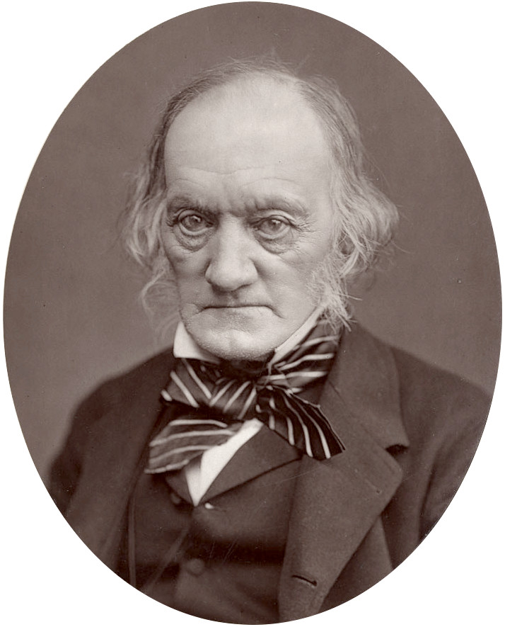
1. Why Not Mentioned in the Bible?
kjv translated in 1611 by King James I
Dinosaur coined by Sir Richard Owen in 1841
Needed a new word to describe the bones he was examining
Deinos [terrible] + sauros [lizard]

Slide 4
2. When Were They Created?
Gen. 1:24 – “Day 6, Day 6 – God made animals and man that day.”
Ex. 20:11 – “all” – “used to refer to the whole quantity or extent of a particular group or thing.”
Man and dinosaurs were created the same day – they lived together.

Slide 5
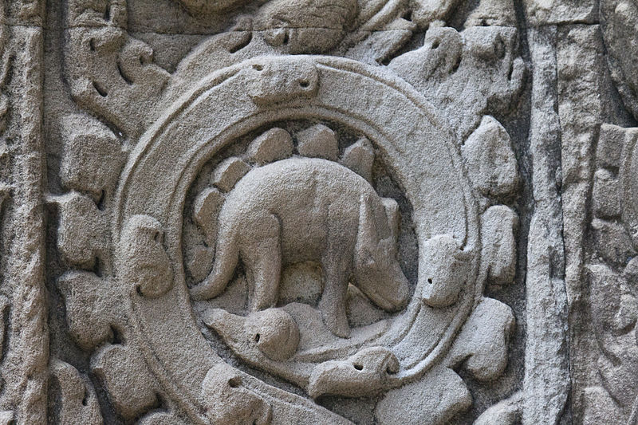

Slide 6
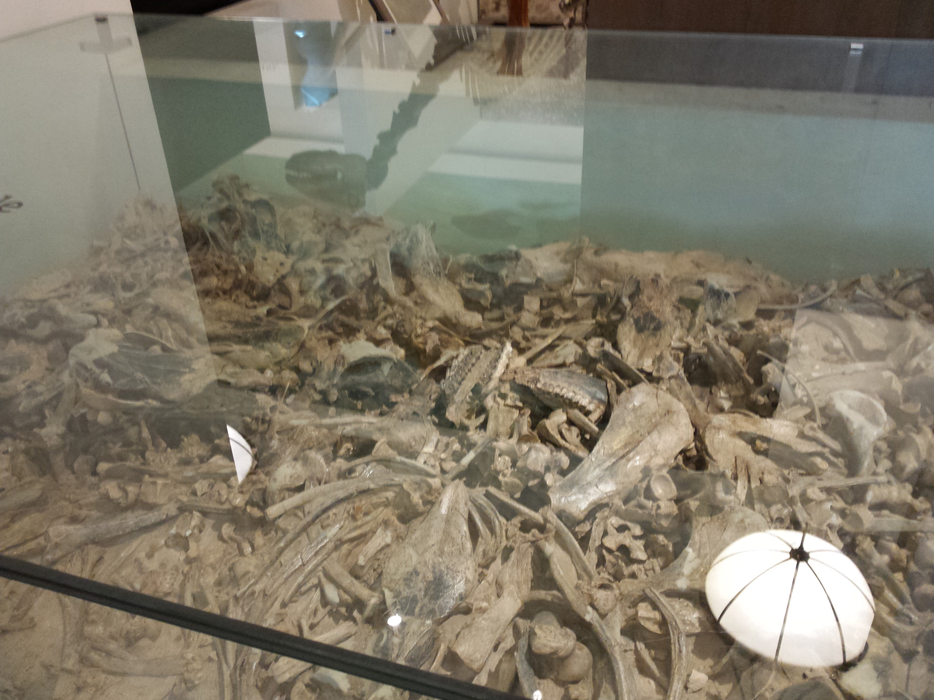

Slide 7
3. Biblical Mentions of Dinosaurs
Job 40 – Behemoth
38:1-38 – 20 inanimate: foundation; ocean; morning; sea springs; deep recesses; gates of death; earth expanse; light/darkness; snow; hail; light; wind; rain; thunderbolts; dew; ice; constellations; laws of universe; clouds; lightening = all real
38:39-40:34 – 9 animals: lion; raven; mtn. goat; wild donkey; wild ox; ostrich; war horse; hawk; eagle = all real
Logically the next two items will also be real

Slide 8
3. Biblical Mentions of Dinosaurs
Job 40 – Behemoth anatomy
16: strong stomach muscles: hippo? elephant?
17: cedar-like tail: literal? No, simile. hippo? elephant? rhino?
18: bones like brass: literal? No, simile. Elephant: 5-7 tons; hippo: 3-4 tons; Argentinosaurus: 80-100 tons.
Conclusion: had to be a dinosaur!

Slide 9
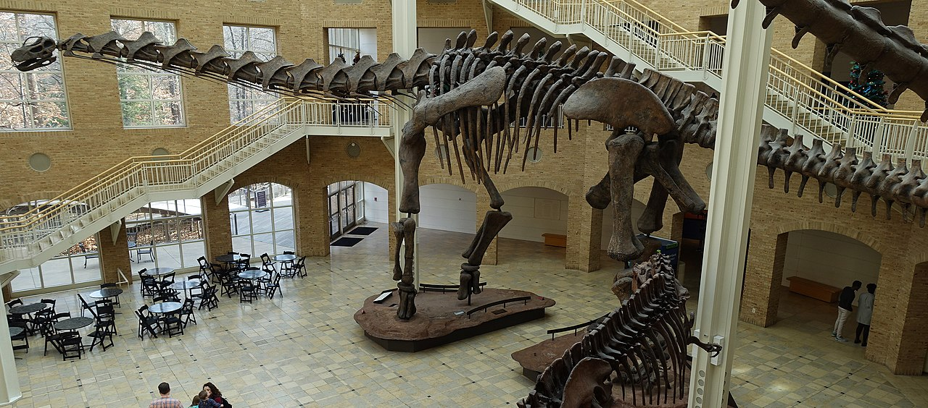

Slide 10
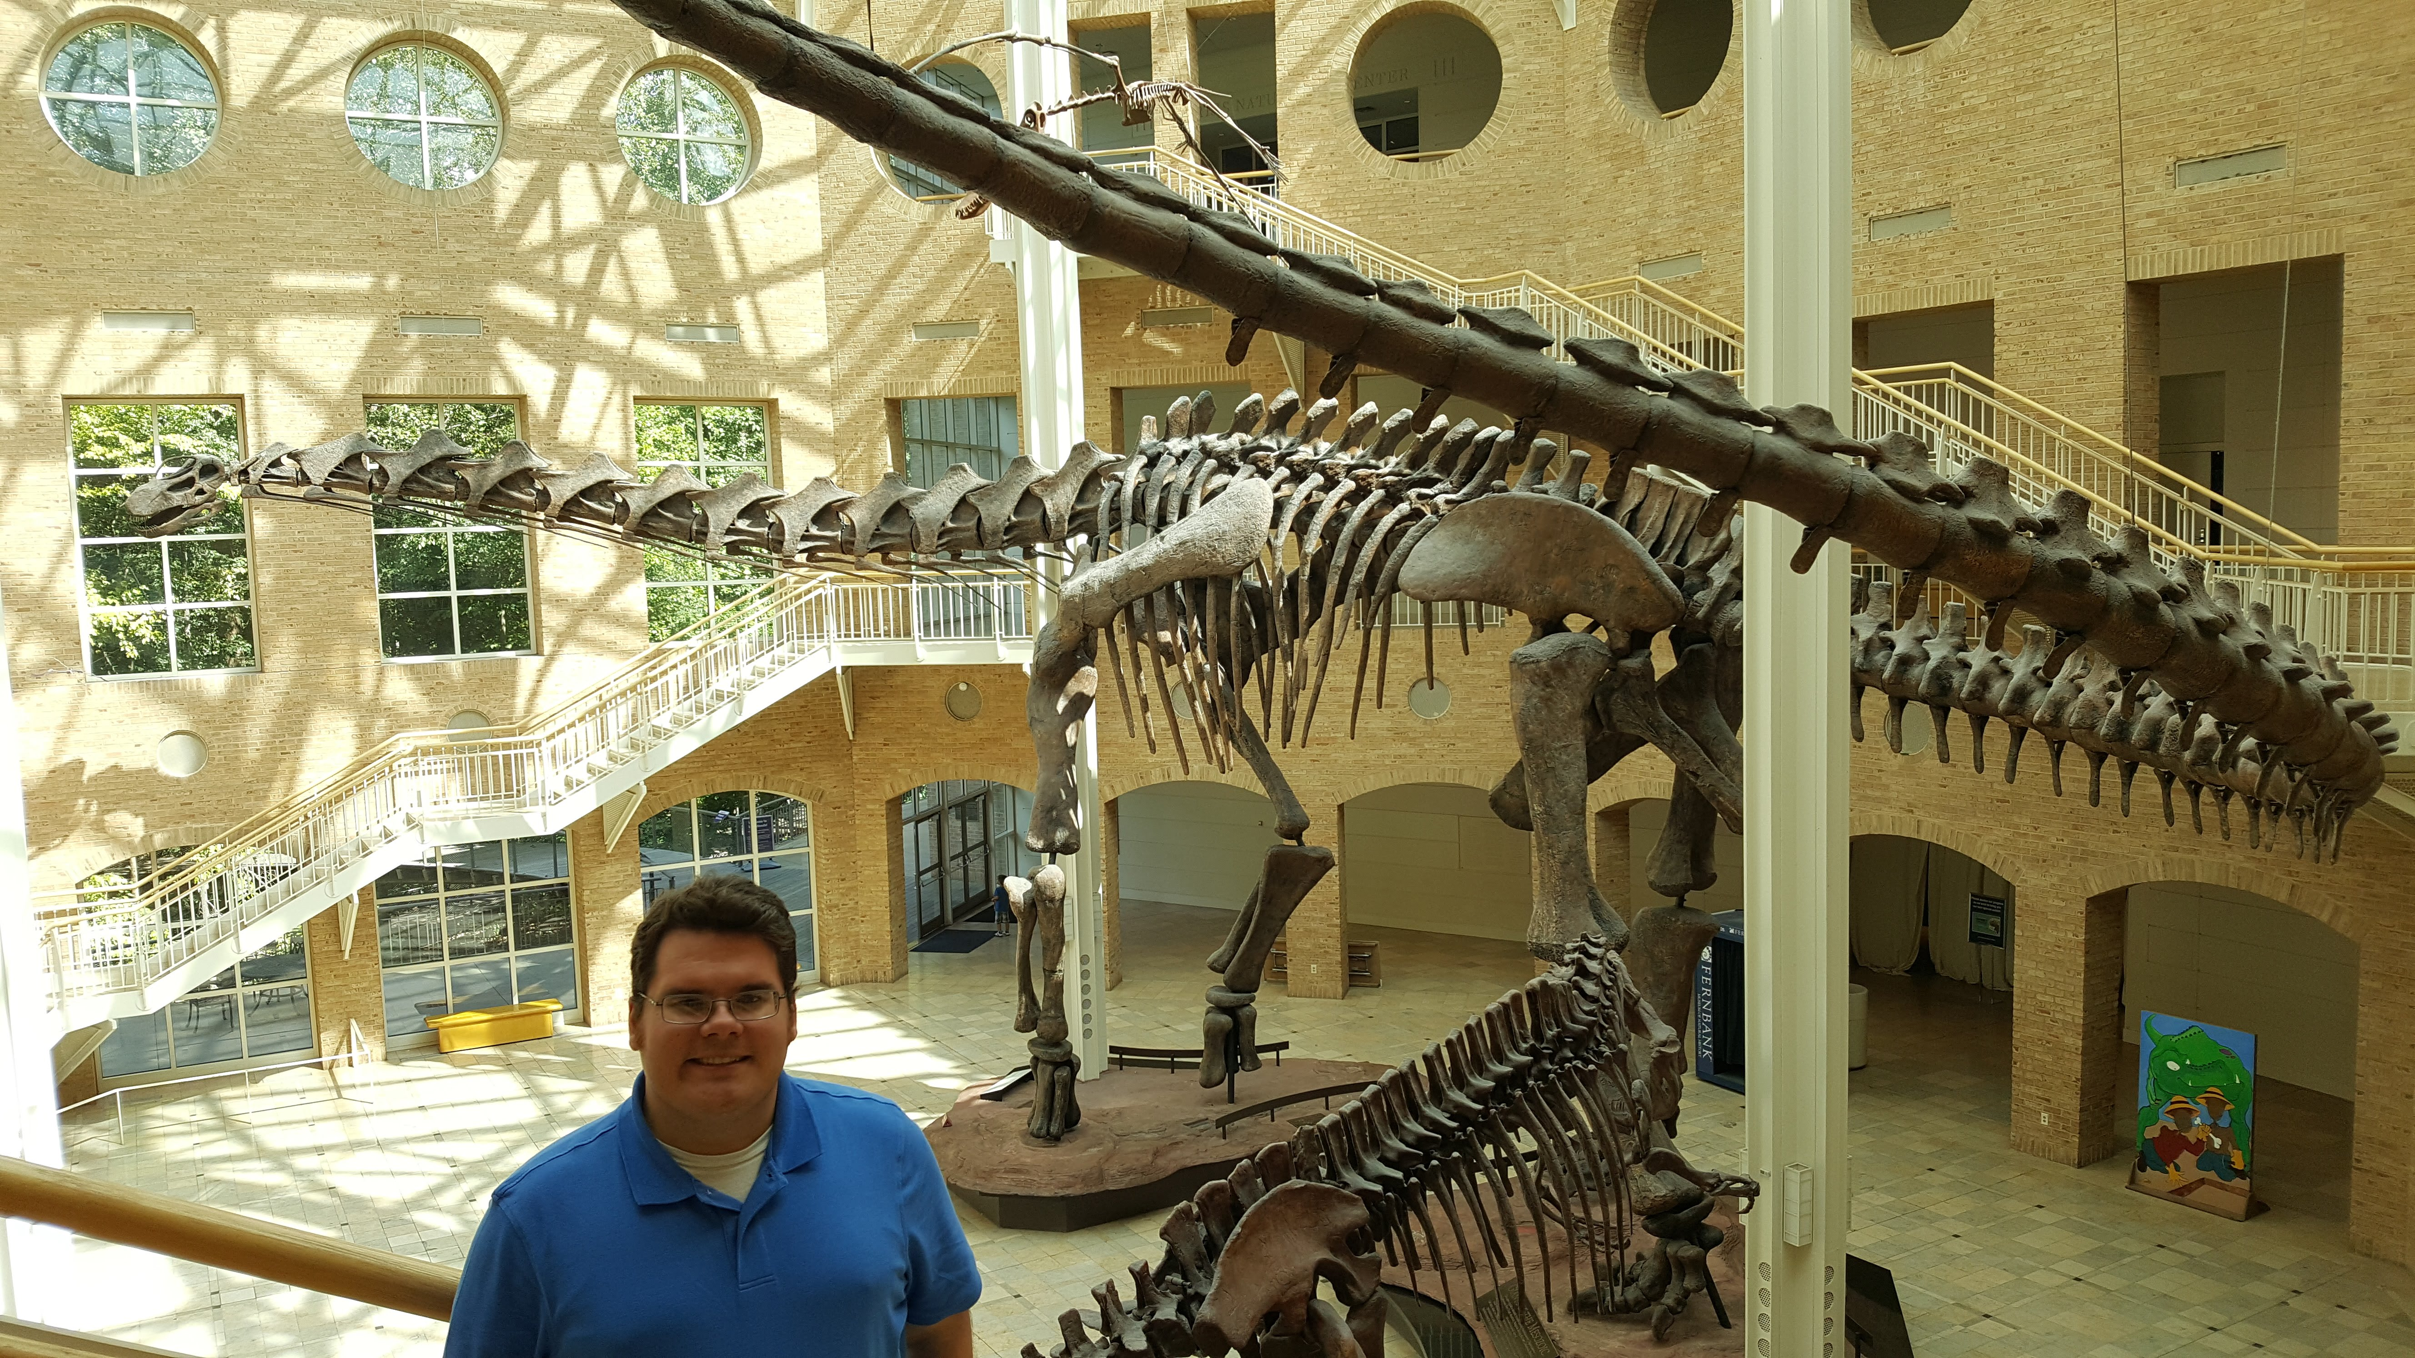

Slide 11
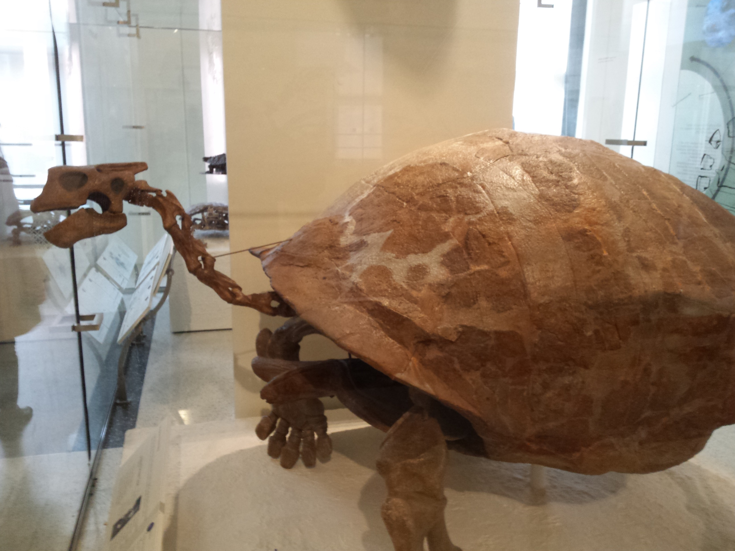

Slide 12
3. Biblical Mentions of Dinosaurs
Job 41 – Leviathan
Gen. 1:20-23: Day 5 – great sea creatures
34 verses devoted to this creature!
14 rhetorical questions [1-10a]
Anatomy [12-24]: 18-21 describe literal fire-breathing
How could the Leviathan not be a dinosaur?
Main point: God created the Leviathan, 33-34, making YHWH greater than this beast!

Slide 13
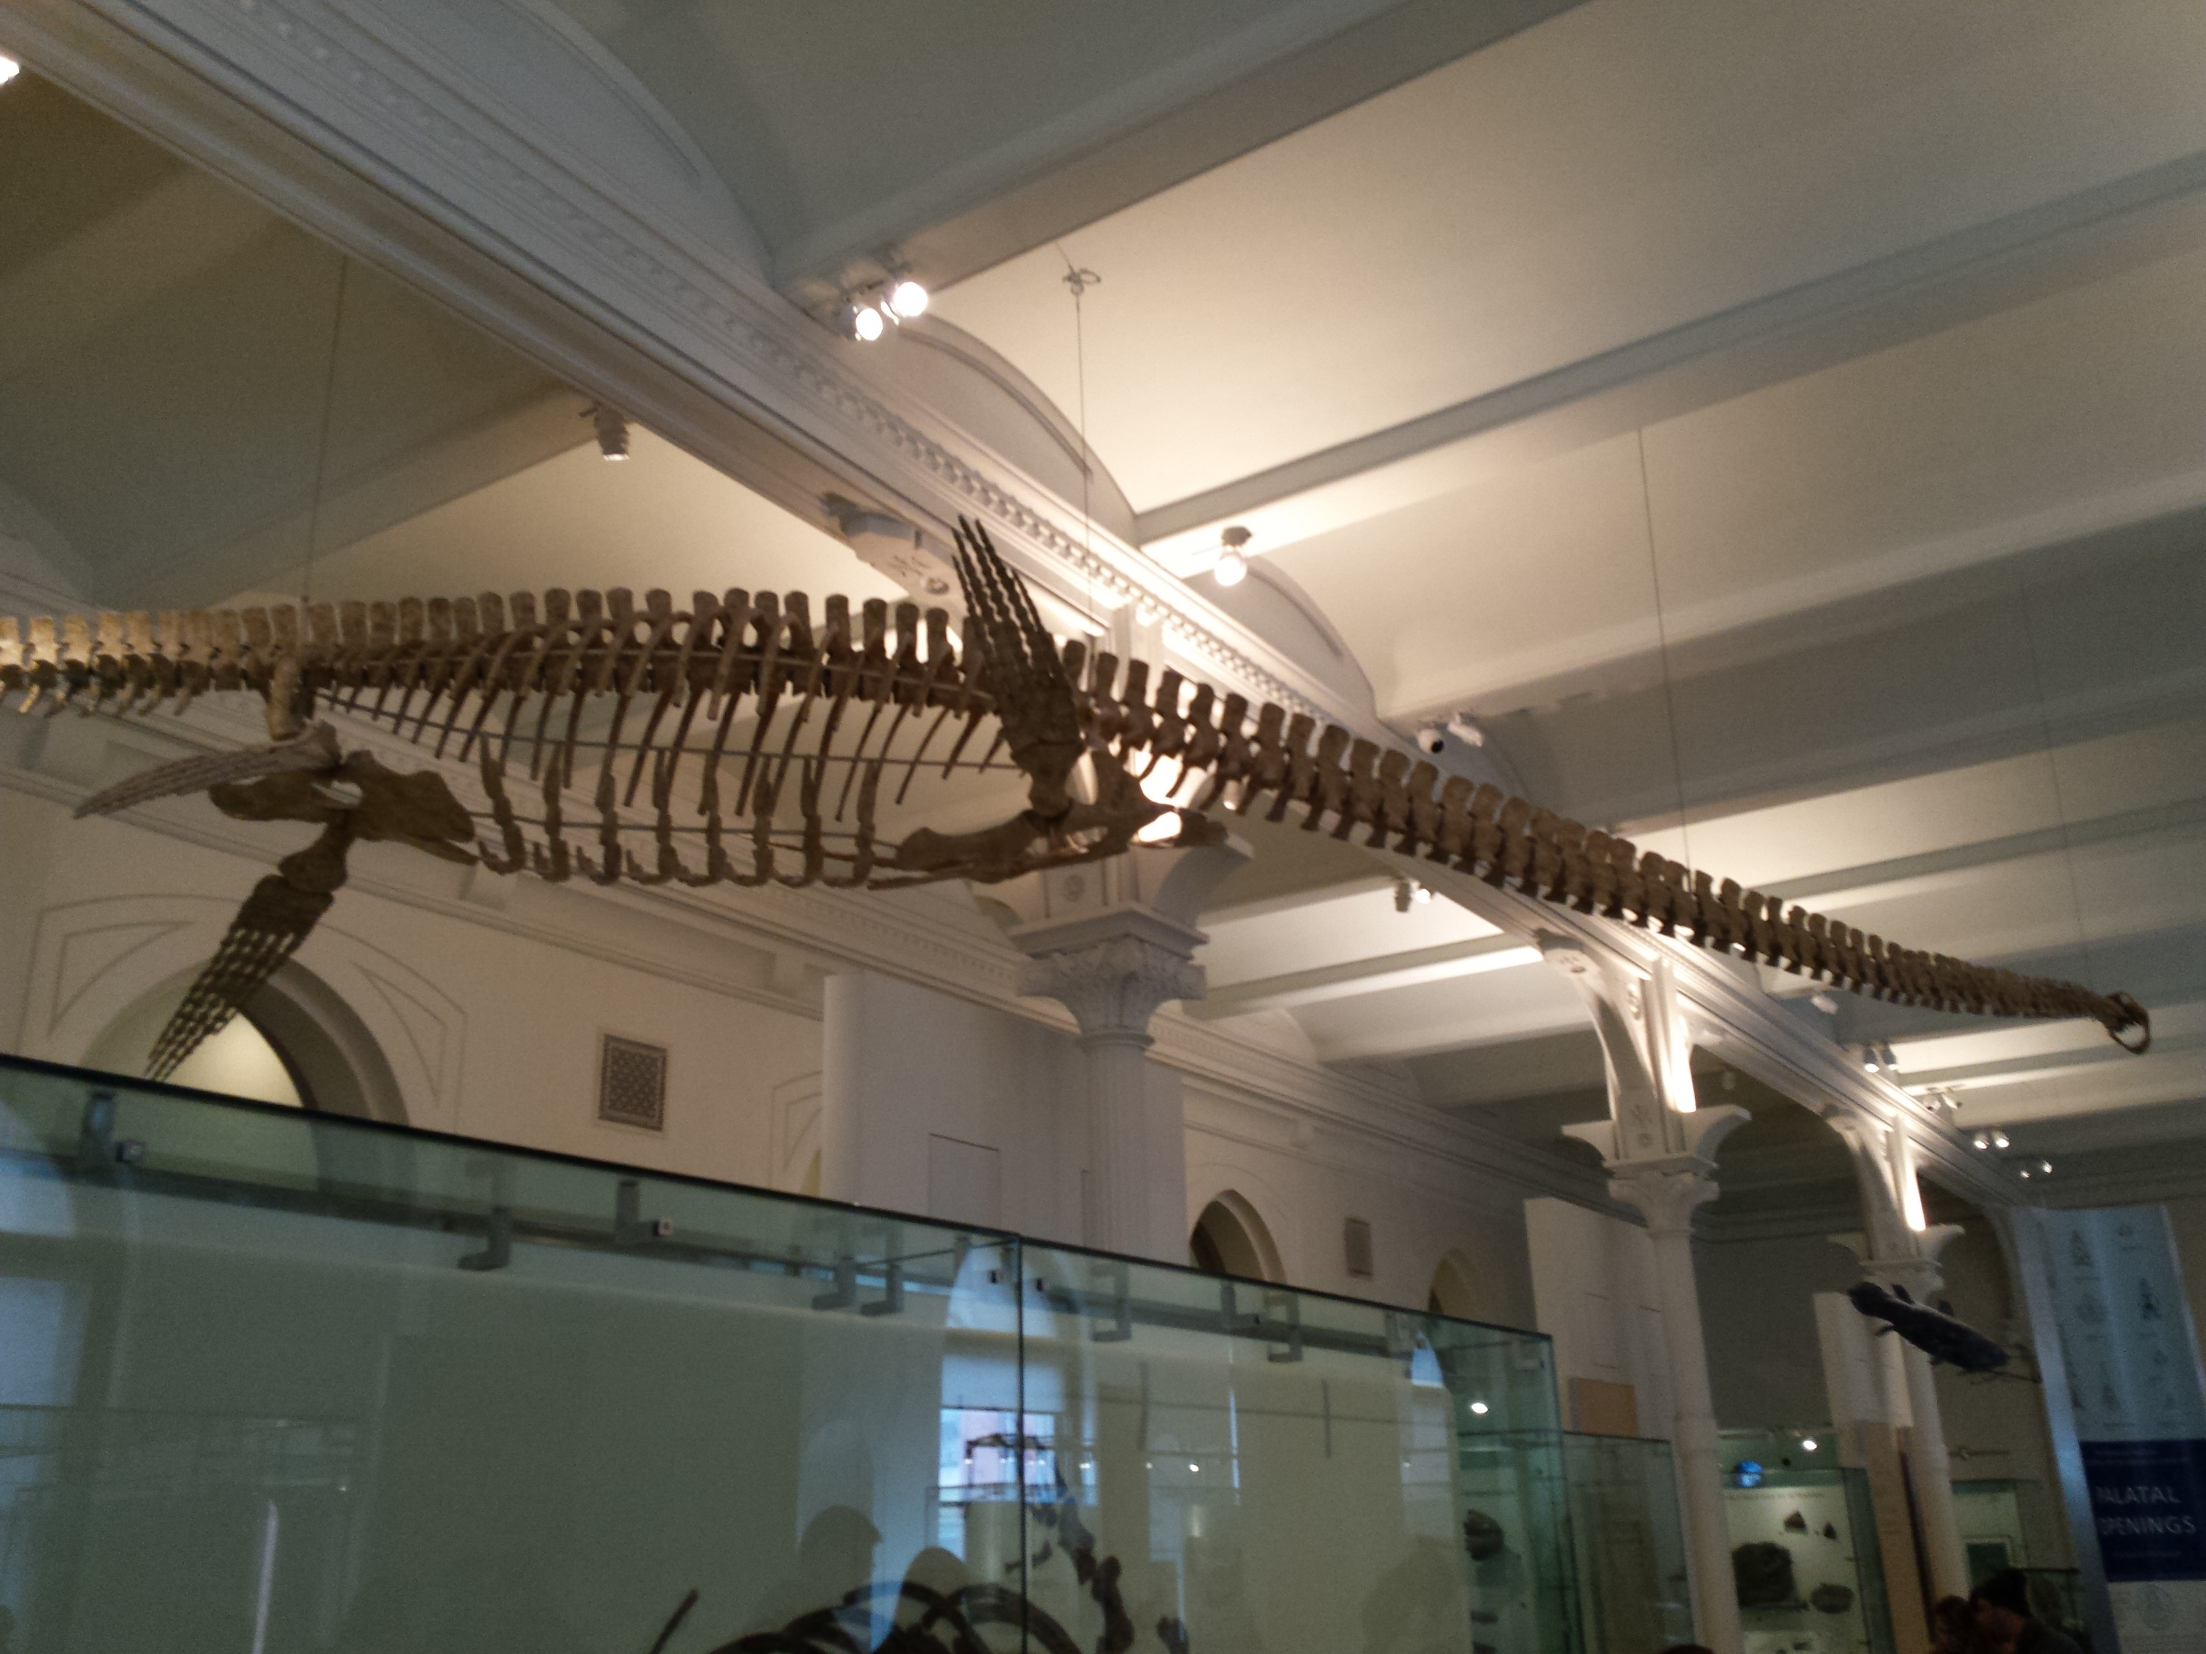

Slide 14
3. Biblical Mentions of Dinosaurs
Isaiah 14:29; 30:6
“There is a place in Arabia, situated very near the city of Buto, to which I went, on hearing of some winged serpents; and when I arrived there, I saw bones and spines of serpents, in such quantities as it would be impossible to describe: …The form of the serpent is like that of the water-snake; but he has wings without feathers, and as like as possible to the wings of a bat” (Herodotus, 1850, Book II, LXXV, pp. 75-56).

Slide 15
3. Biblical Mentions of Dinosaurs
Isaiah 14:29; 30:6
“For when the ground was difficult to be passed over, because of the multitude of serpents, Moses invented a wonderful stratagem to preserve the army safe, and without hurt; for he made baskets, like unto arks, and carried them along with them; which animal is the greatest enemy to serpents imaginable, for they fly from them when they come near them;” (Josephus, Flavius, Book II, Chapter X, p.58).

Slide 16
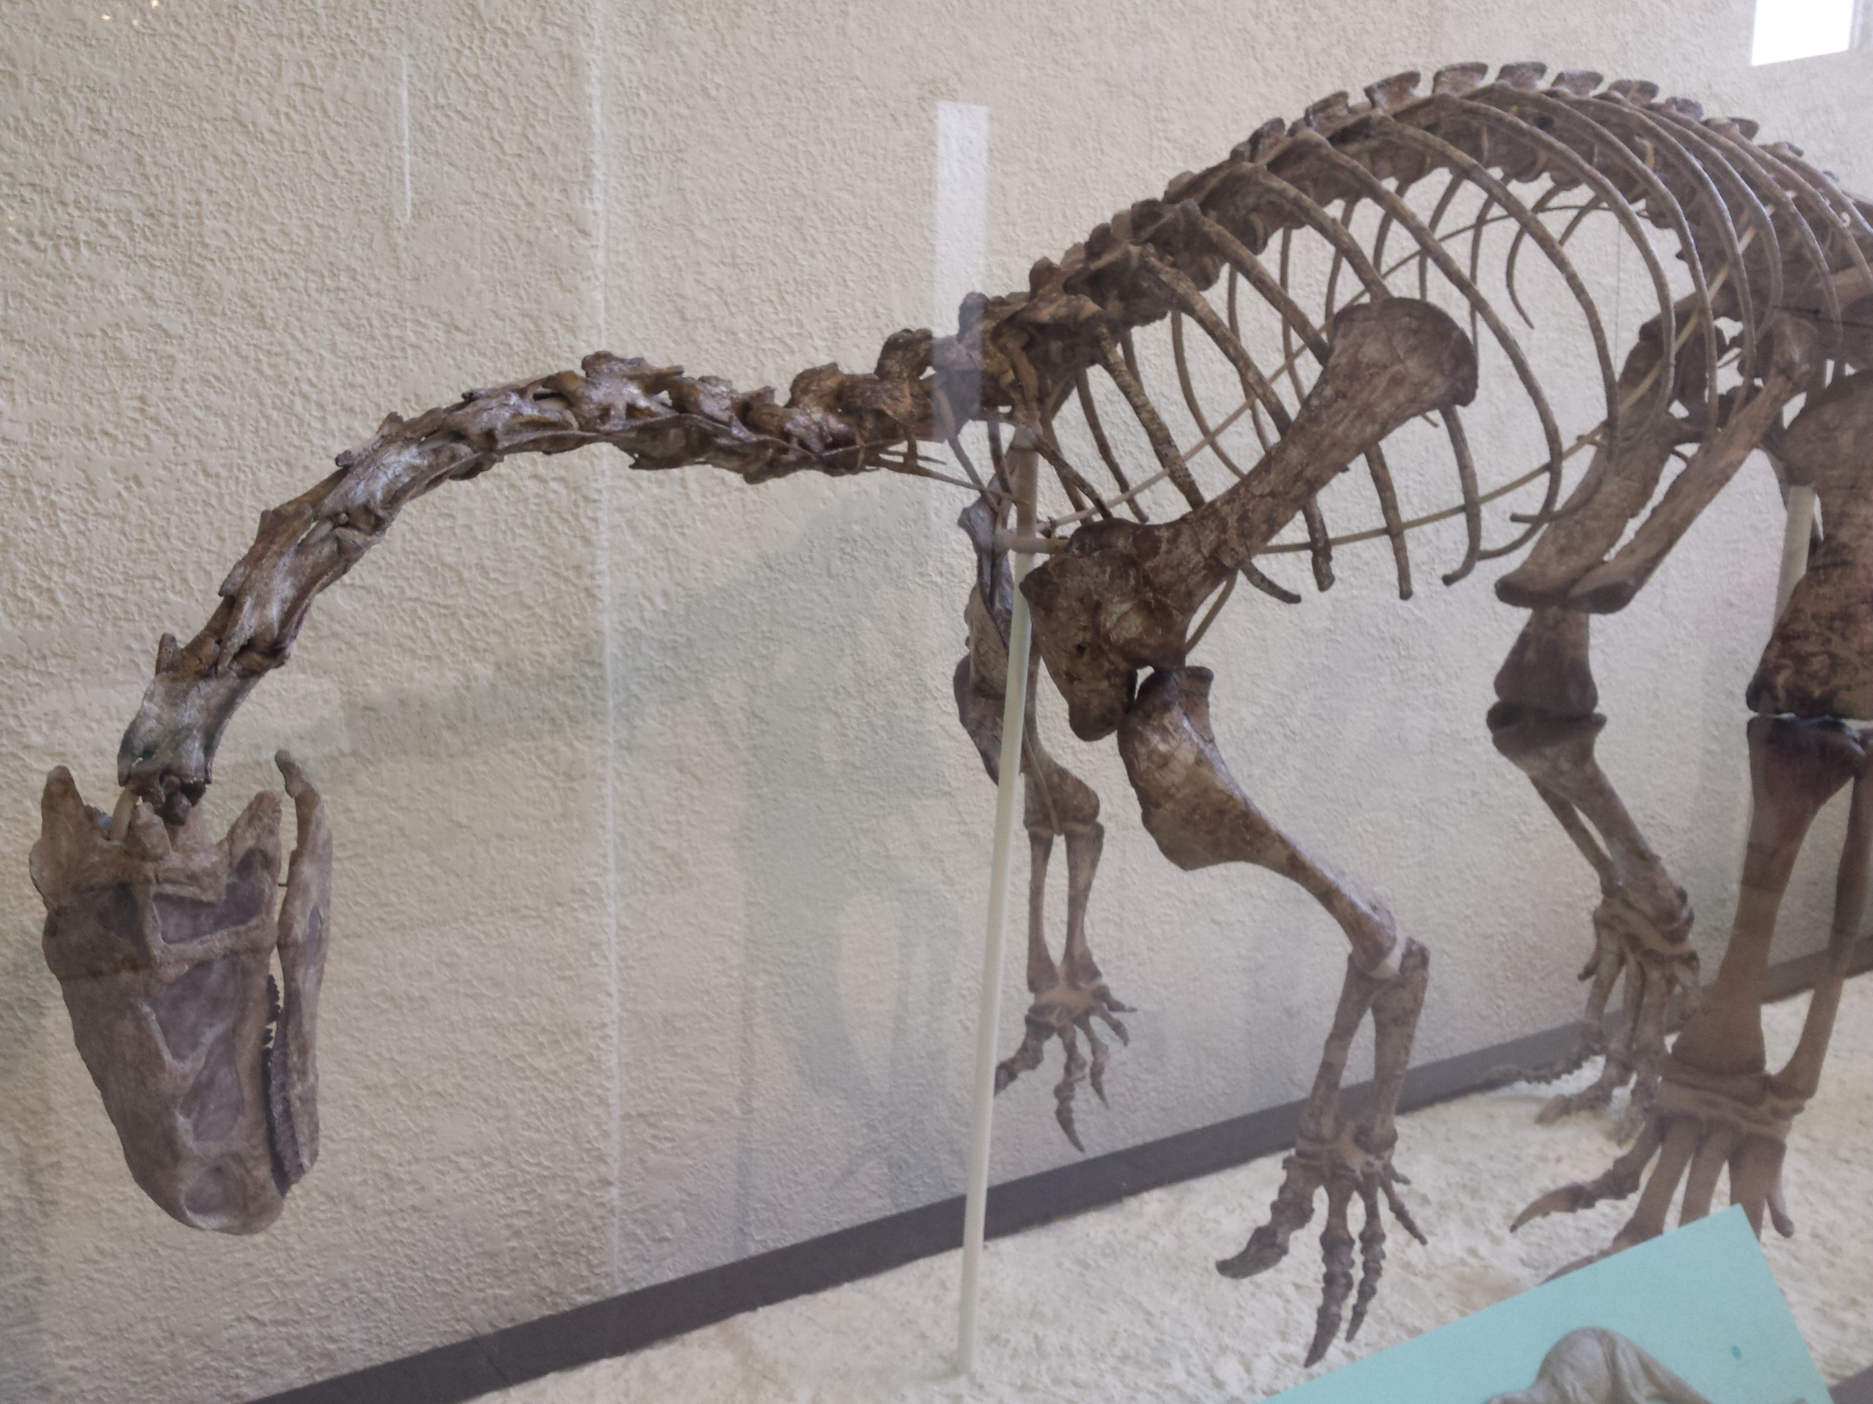

Slide 17
Lessons
Dinosaurs were created on the same day as man; they lived together with dinosaurs being submissive to man’s dominion.
The reason we do not read the word dinosaur in the Bible is because the word dinosaur was invented over 200 years after the King James Version was released.
Don’t believe what the world wants you to believe about the absurd claims of dinosaurs; instead, open God’s Word and study to see what He has revealed for us!

Slide 18
For a copy of these notes: thejustinreedshow.com/bibleresources or Google: Justin Reed Bible VBS Notes > Notes & PowerPoint

Slide 19
Sermon © 2021 Justin D. Reed Presentation © 2021 Justin D. Reed
Provided free through Justin Reed’s Bible Resources Post Office Box 292, Woodbury TN 37190 thejustinreedshow.com/bibleresources
“To God be the Glory!”
150
Fossil pictures taken at the American Museum of Natural History in New York City on Sunday, March 8, 2015 by Justin D. Reed. © 2015
“Argentinosaurus & Justin Reed” photo taken September 18, 2018 by Sara Reed at the Fernbank Natural History Museum, Atlanta, GA. © 2018
All other photos courtesy of Wikipedia.

